Slide 1

KGDNet – Medicine Recommendation System
Names:
Muhammad Zakariya (37581)
Muhammad Mehtab Jabbar (37582)
Muhammad Subhan Saeed (37819)

Slide 2
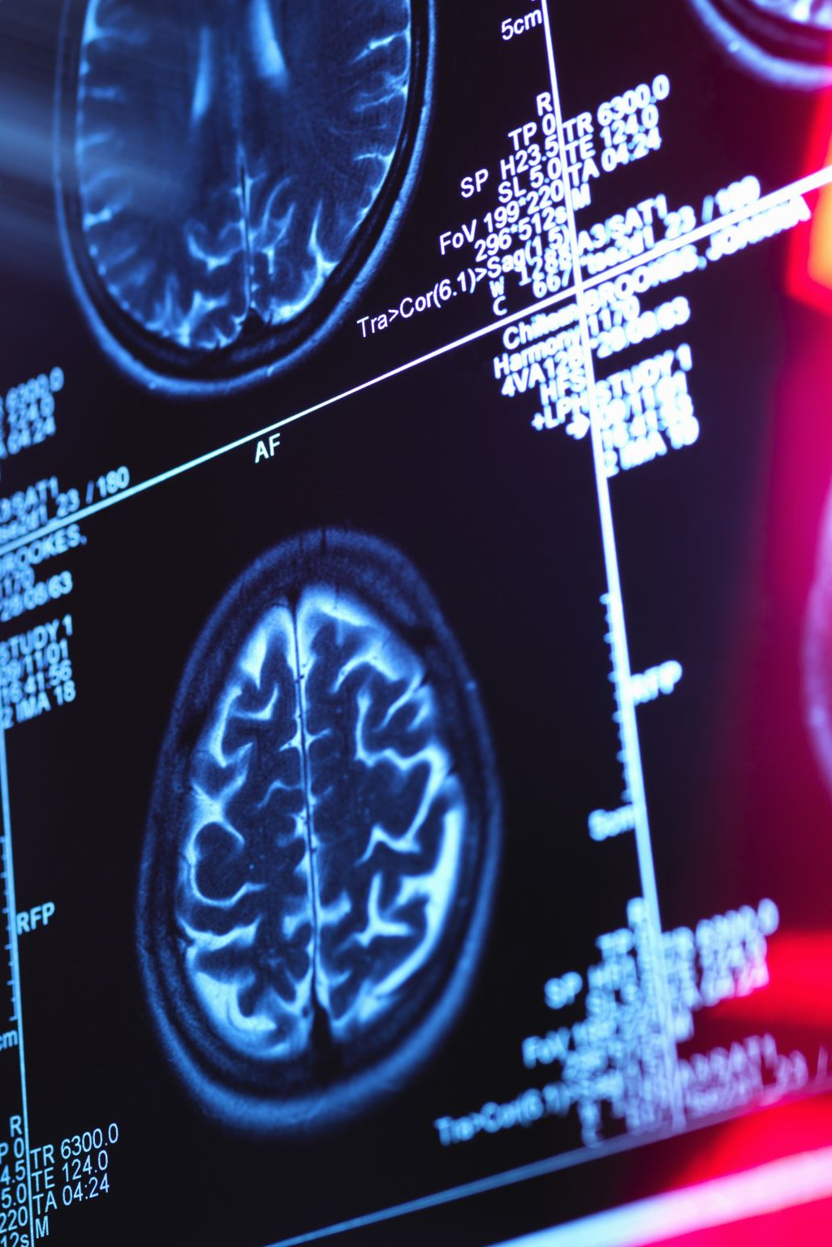
Introduction
Artificial Intelligence (AI) and Machine Learning (ML) are transforming healthcare.
Medicine Recommendation Systems assist doctors in selecting safe medicines.
Electronic Health Records (EHRs) provide rich patient data.
Traditional systems fail to capture full patient history.

Slide 3
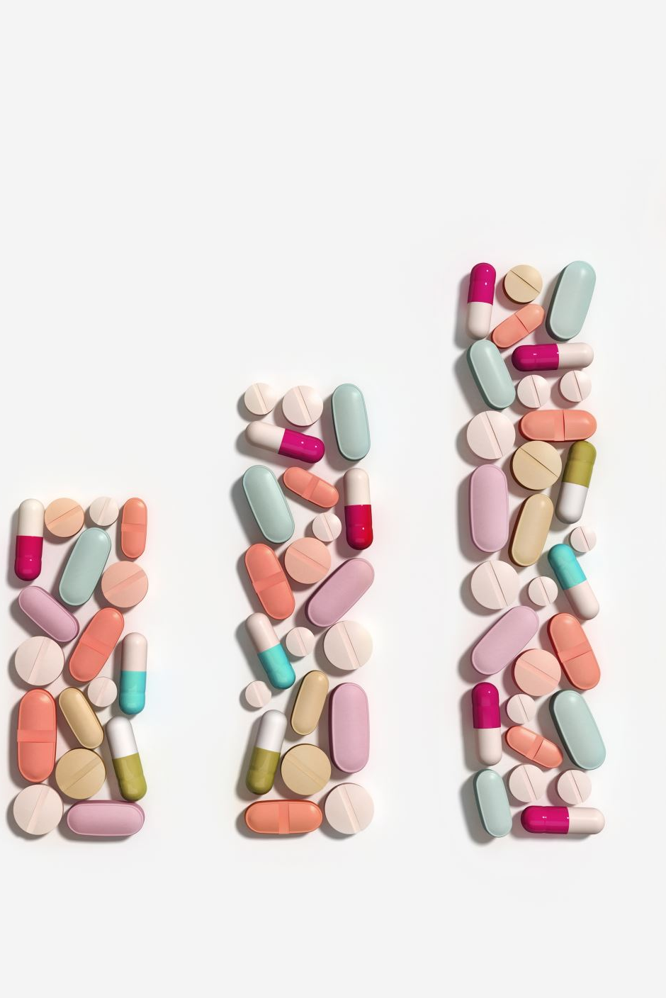
Problem Statement
Traditional systems:
Rely on static or rule-based logic
Ignore longitudinal patient records
Poor handling of Drug–Drug Interactions (DDIs)
This can lead to unsafe prescriptions.

Slide 4

Methodology Flow
Steps followed in Collab notebook:
Load & prepare data from MIMIC-IV demo.
Concatenate patient demographics, admissions, diagnoses, and prescriptions.
One-hot encode categorical features.
Set target = Aspirin prescription.
Train–test split.
Train Random Forest Classifier.
Evaluate with accuracy, precision, recall, F1, ROC

Slide 5
Proposed Solution KGDNet
KGDNet integrates EHR data with medical knowledge graphs.
Uses GRU with attention for temporal learning.
Uses Graph Neural Networks for relational learning.
Goal: Accurate and safer medicine recommendation.

Slide 6
System Architecture
1. Patient visit sequences (EHR)
2. Knowledge Graphs (Drugs, Diseases, Symptoms, DDI)
3. GRU + Attention mechanism
4. Graph Neural Network (GNN)
5. Medicine prediction layer

Slide 7
Working Mechanism
Patient visits processed sequentially.
Attention highlights important visits.
Knowledge Graph provides medical relations.
GNN refines embeddings.
Final fusion outputs medicine recommendations.

Slide 8
Knowledge Graph Importance
Captures drug–drug interactions (DDI).
Models drug–disease relationships.
Improves safety and interpretability.
Reduces harmful drug combinations.

Slide 9
Datasets Used
MIMIC-III:
ICU EHR data
Diagnoses, procedures, medications
MIMIC-IV:
Updated and larger dataset
Used for evaluation

Slide 10
Results & Performance
KGDNet Results:
F1 Score ≈ 0.68
Jaccard Similarity ≈ 0.52
Lower DDI Rate
Outperforms baseline models.

Slide 11
Comparison with Existing Models
RETAIN: Interpretable but weak temporal modeling.
GAMENet & MedGCN: Higher accuracy but safety issues.
KGDNet: Best balance of accuracy and safety.

Slide 12
Limitations
Knowledge graph construction is complex.
Scalability challenges.
Limited generalization.
No real-world deployment yet.

Slide 13
Conclusion
KGDNet combines patient history with medical knowledge.
Improves accuracy and patient safety.
Promising future for AI-driven clinical decision systems.

Slide 14
References
1. Zhang et al., “KGDNet: Knowledge-Guided Drug Recommendation Network,” Scientific Reports, 2024.
2. Lee et al., “GraphCare: Graph Neural Network for Drug Recommendation,” ICLR, 2024.
3. Gupta et al., “KindMed: Knowledge-Integrated Drug Recommendation,” arXiv, 2023/24.
4. Li et al., “MGRN: Multi-View Graph Retrieval Network,” Bioinformatics, 2024.
5. Wang et al., “BiMoRec: Bi-Modal Medication Recommendation,” arXiv, 2024/25.
6. Johnson et al., “MIMIC-III & MIMIC-IV Clinical Databases.”

